Slide 1
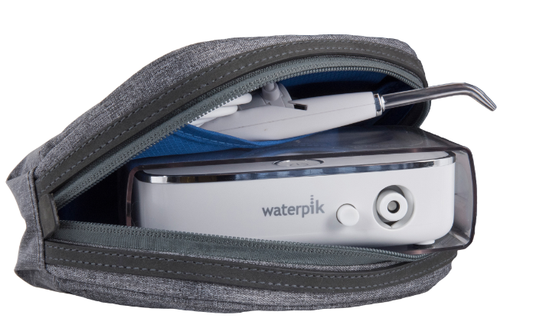
Countertop Performance In A Super
Compact Size - Perfect For On-The-Go Patients
Or Those With Small Counter Space!
1
Includes Premium Travel Case
Enhanced Pressure Performance
Three Year Limited Warranty
Tip Handle Included
Ideal for Travel
Space Saving Design* Fits in Purse
Notes:
Highlight important product features. [The product slides are the perfect opportunity to mention the trial unit price. The L&L trial unit price for Sidekick is $54.99]. MSRP is $129.99.

