Slide 1
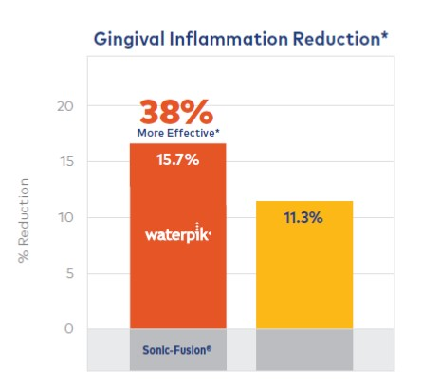
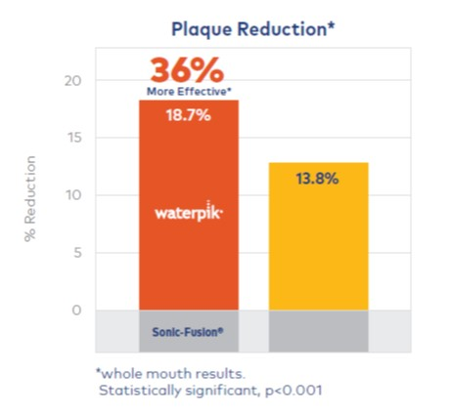
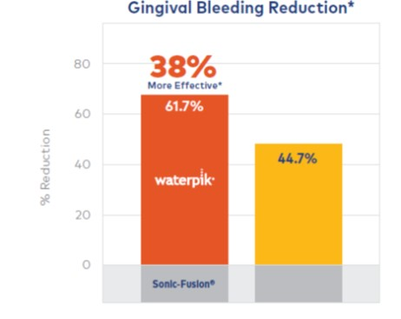
Waterpik® Sonic-Fusion is More Effective than a High-End Sonic Toothbrush
at Removing Plaque, Reducing Bleeding and Inflammation
Randomized, controlled, parallel clinical trial with 35 subjects in each group.
All subjects received written and verbal instructions.
Measurements take at 2 weeks and 4 weeks.
Goyal CR et al, Compendium Contin Ed Dent 2018; 39(Suppl 2): 14-20
Notes:
Sonic-Fusion is the ideal device for patients who are looking for the easiest, most convenient way to floss. In this study, subjects brushed for two minutes followed by one minute of WF with water. The results found that SF was superior to traditional brushing and flossing for removing plaque and reducing bleeding and gingivitis.

