Slide 1
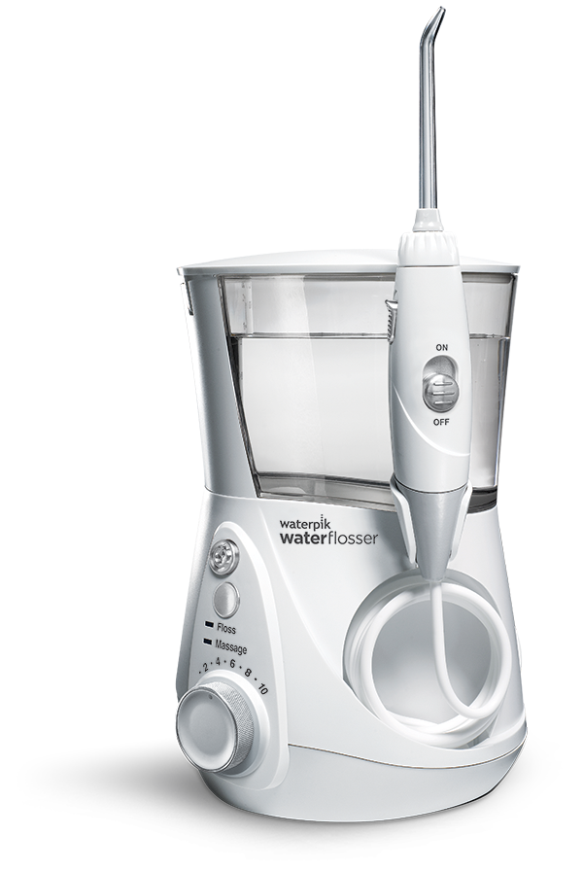
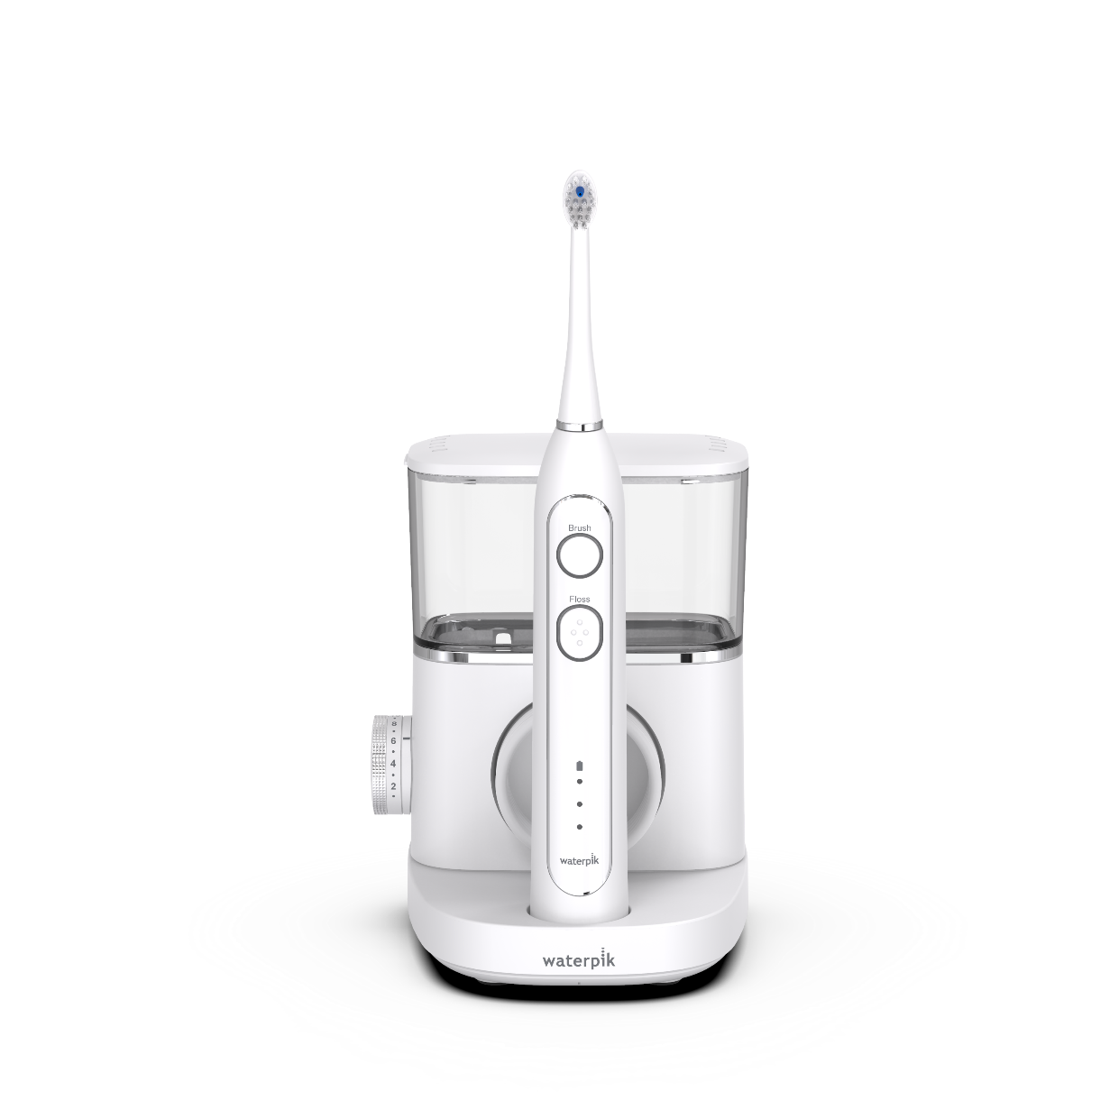
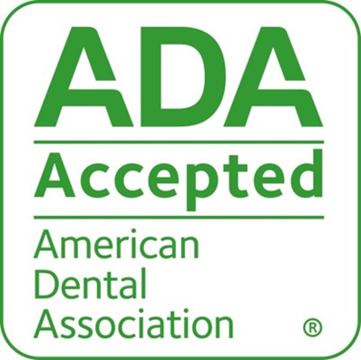
ADA Seal Statement
“Based on the finding that the product is safe and has shown efficacy for removing plaque along the gumline and between teeth and helping to prevent or reduce gingivitis, when used as directed.”
Notes:
The Waterpik® Water Flosser earned the ADA Seal of Acceptance in 2017. It was the first powered interdental product to earn the Seal.

